Slide 1
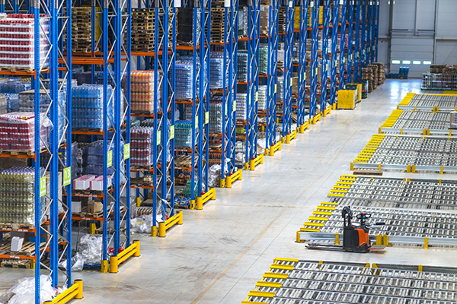
MSR Store

Slide 2
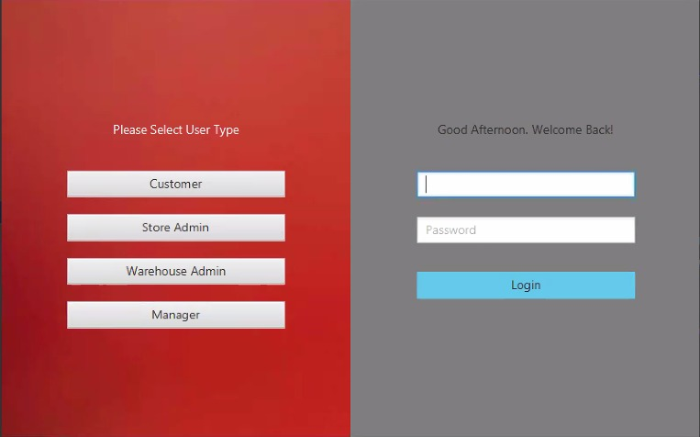
As we see here the login window has 4 users

Slide 3
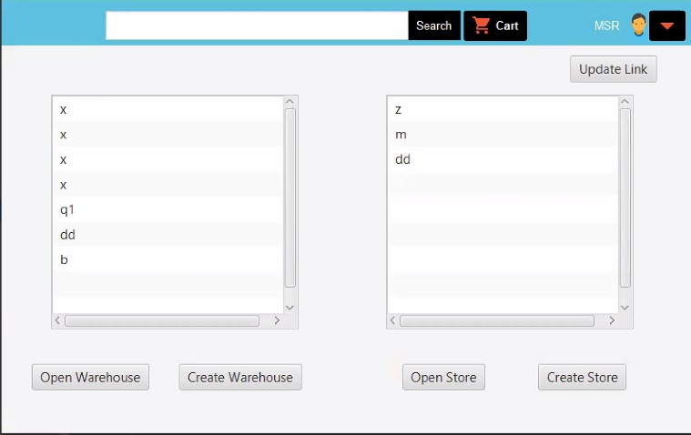
In this window as we show when the manger login he can open to see the warehouse or create a new one and also can open the store to see the products or create a new one

Slide 4
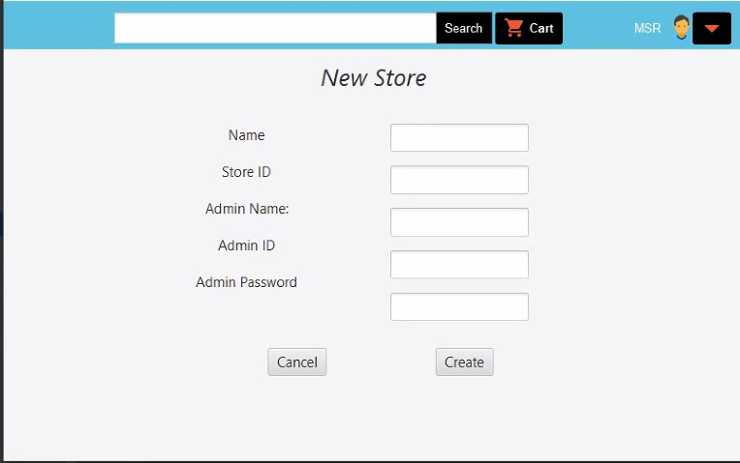
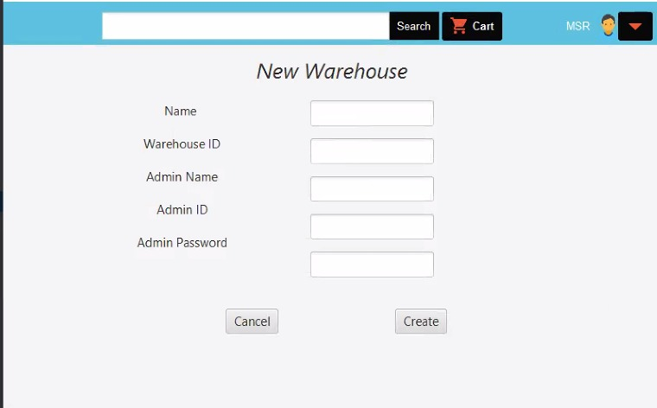
If the manger want to add new warehouse this window will appear to him or add new store

Slide 5
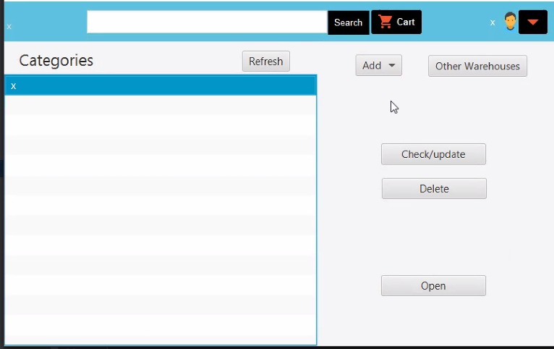
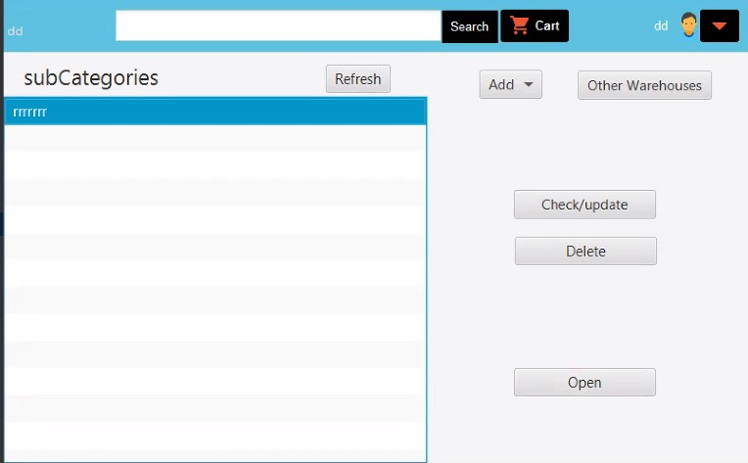
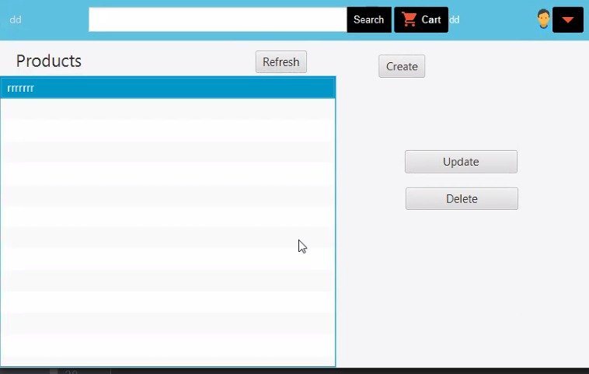
As we see here, this window will open when the store admin or the warehouse admin login to the store the categories will appear to them they can make check/update to the store product or delete items

Slide 6
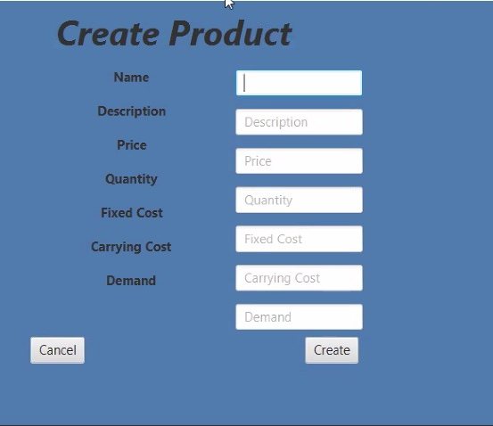
For this window the warehouse and store admin can create a new product

Slide 7
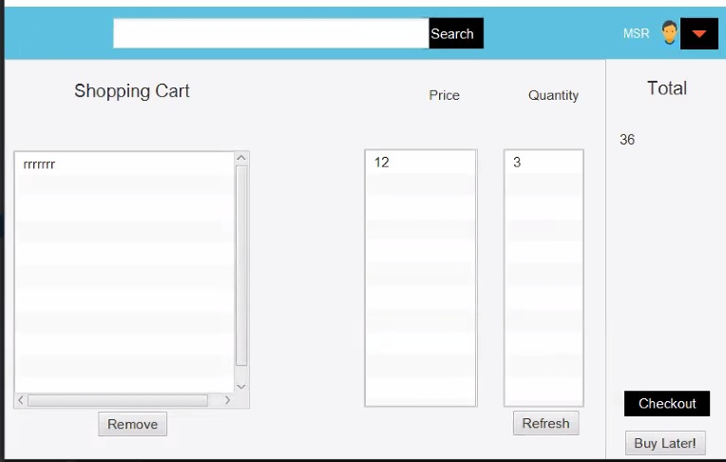
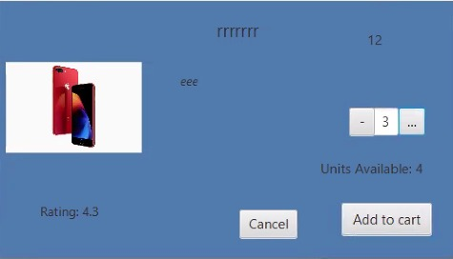
This windows will appear when the customer login and choose the product and select the amount of them.

Slide 8
Thank you!

